Slide 1
Image ve Container
Giriş

Slide 2

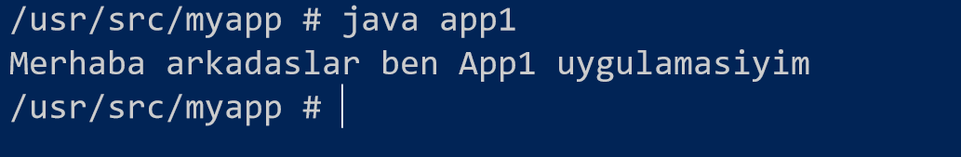

app1
app1

Slide 3




Image
Image
app1
kernel
uygulamalar

Slide 4
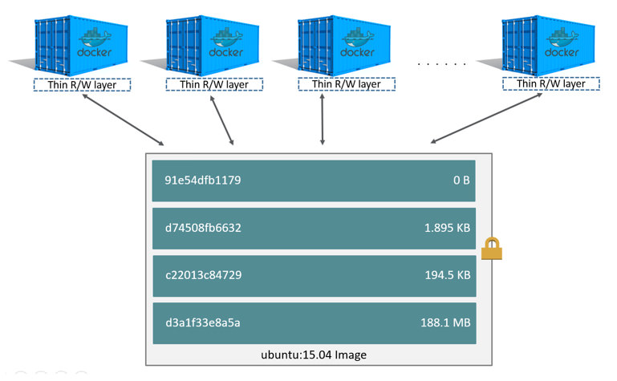
Container

